Slide 1
NIST “WORD”
ABOUT
UNCERTAINTY

Slide 2
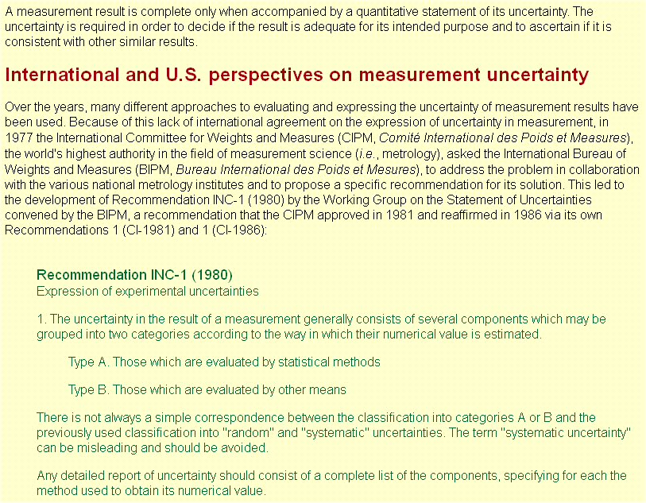
NIST “word” about Uncertainty

Slide 3
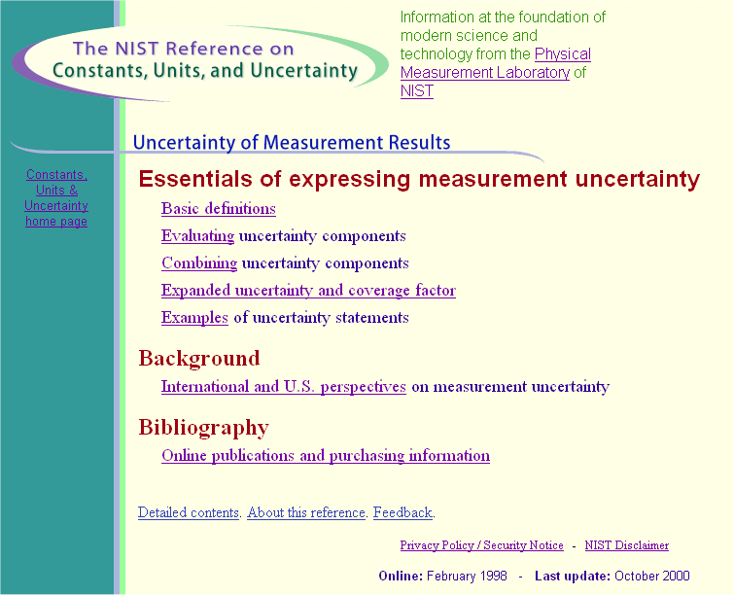
NIST “word” about Uncertainty

Slide 4
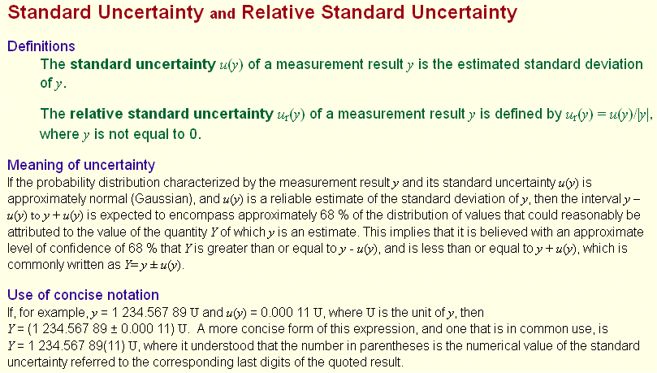
NIST “word” about Uncertainty

Slide 5
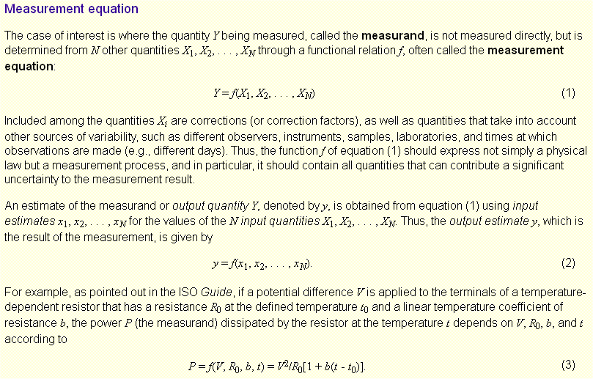
NIST “word” about Uncertainty

Slide 6
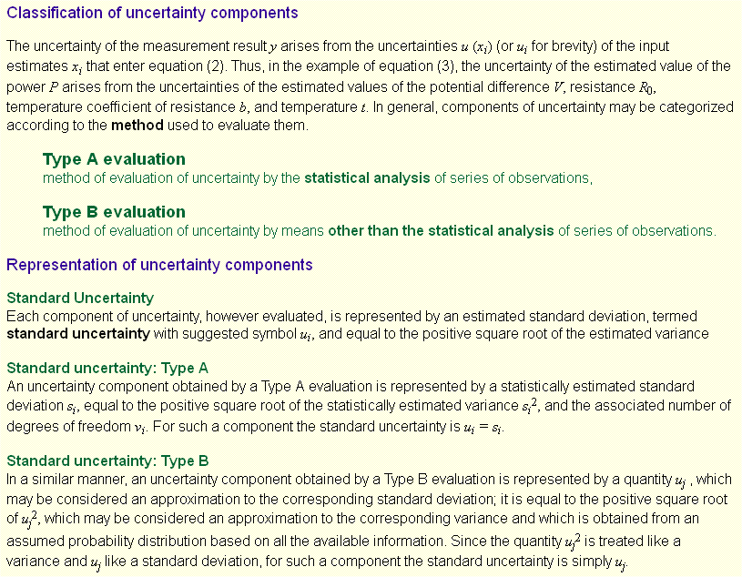
NIST “word” about Uncertainty

Slide 7
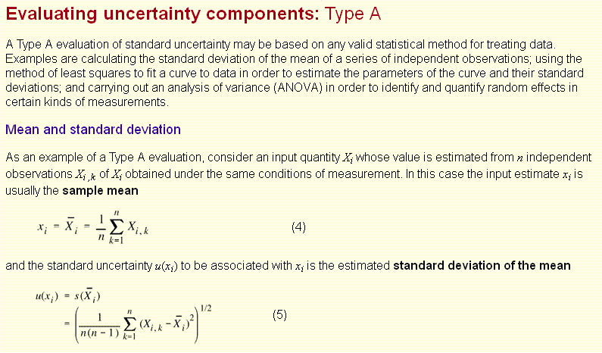
NIST “word” about Uncertainty

Slide 8
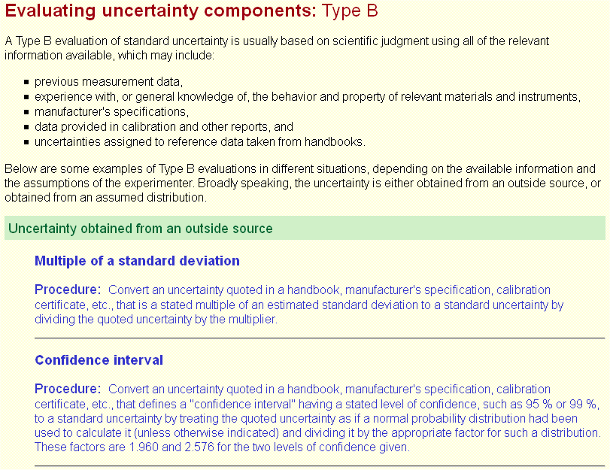
NIST “word” about Uncertainty

Slide 9
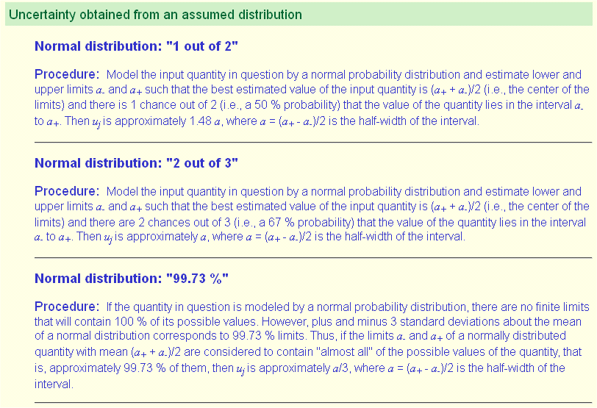
NIST “word” about Uncertainty

Slide 10
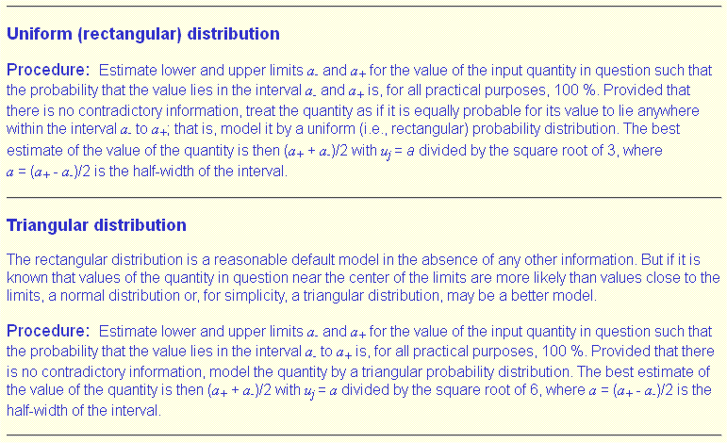
NIST “word” about Uncertainty

Slide 11
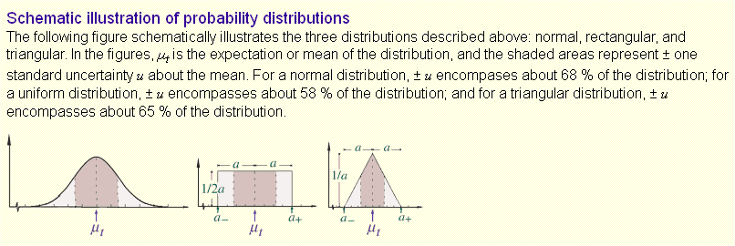
NIST “word” about Uncertainty

Slide 12
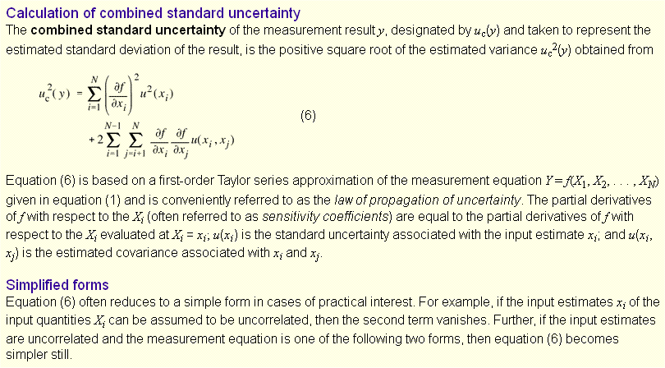
NIST “word” about Uncertainty

Slide 13
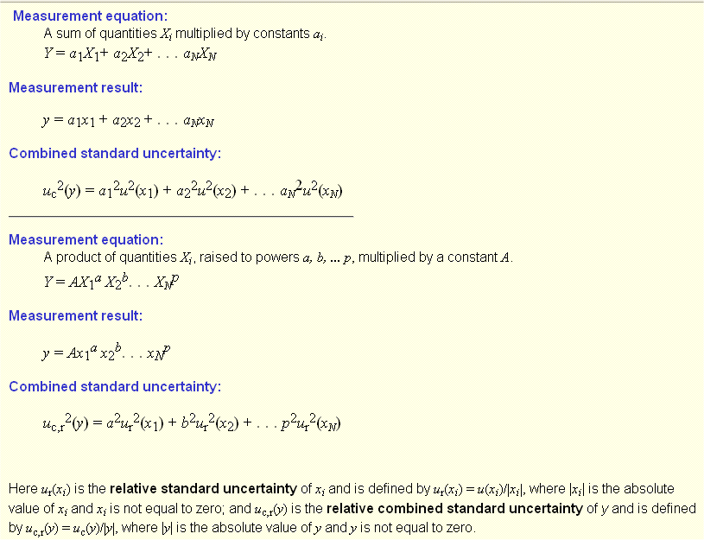
NIST “word” about Uncertainty

Slide 14
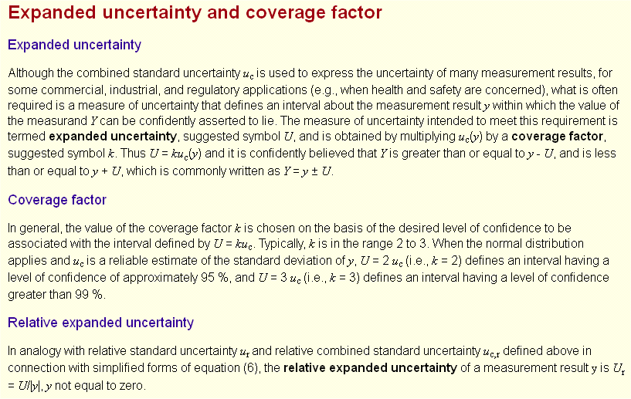
NIST “word” about Uncertainty

Slide 15
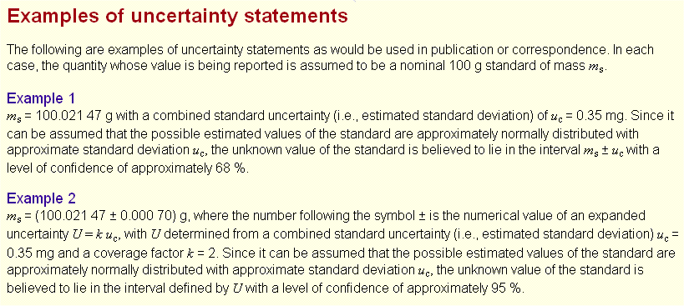
NIST “word” about Uncertainty

Slide 16
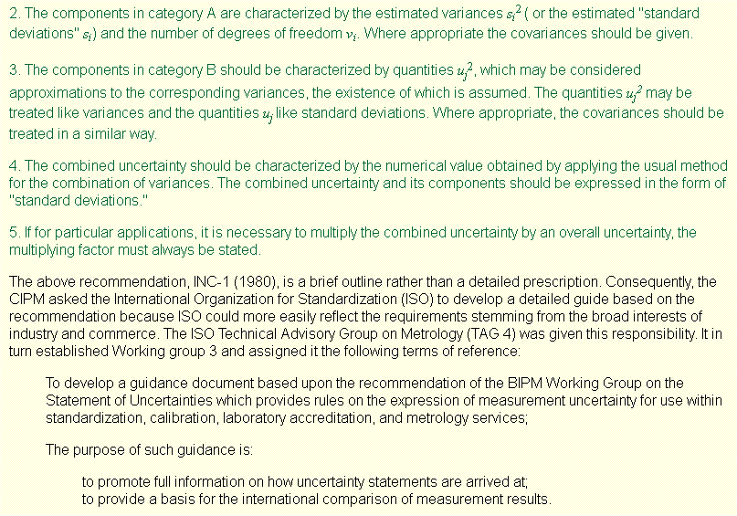
NIST “word” about Uncertainty

Slide 17
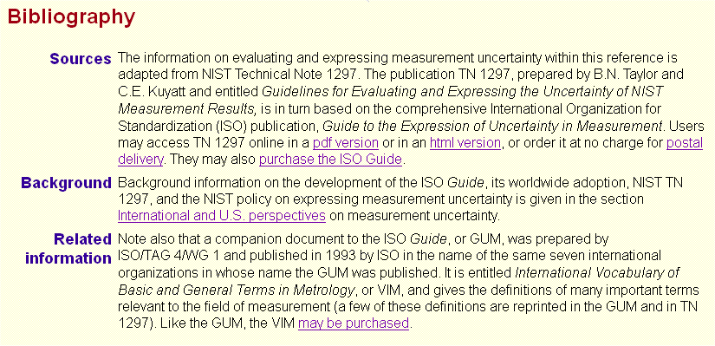
NIST “word” about Uncertainty

Slide 18
NIST “word” about Uncertainty
Le “cose certe” le mettiamo da parte,
per il momento …
le cose incerte possiamo stimarle
e quindi indicarle in maniera corretta!
(parafrasi da Antonio de Curtis)
Perché se non mi diverto studiando,
figuratevi lavorando!

